Slide 1
Predicting House Prices Using Linear Regression Model
Submitted by:
K. Jhansi
S. Vaishnavi
U. Pushpanjali
C. Jyothsna

Slide 2
INTRODUCTION
This presentation provides a comprehensive analysis house prices using a Linear Regression of predicting Model. The model aims to forecast housing prices based on various predictive variables.
Importance of House Price Prediction
Briefly discuss the importance of accurately predicting house prices.
Mention real estate investment, property valuation, and economic indicators
Highlight the role of predictive modeling techniques in making informed decisions.
Overview of Linear Regression
Define linear regression as a statistical method used for modeling the relationship between a dependent variable (house price) and one or more independent variables (features).
Explain its simplicity and interpretability, making it a popular choice for predictive modeling.
Emphasize its application in various fields including economics, finance, and real estate.

Slide 3

UNDERSTANDING LINEAR REGRESSION
Linear Regression is a statistical method to
model the relationship between a dependent
variable and one or more independent variables.
It aims to find the best-fitting line to describe the relationship.
It assumes a linear relationship between the features and the target variable.
The model learns the coefficients that best fit the data and can make predictions for new inputs.
Linear regression is also a type of machine-learning algorithm more specifically
a supervised machine-learning algorithm that learns from the labelled datasets and maps the
data points to the most optimized linear functions.
Supervised learning has two types:
1. Classification
2. Regression

Slide 4
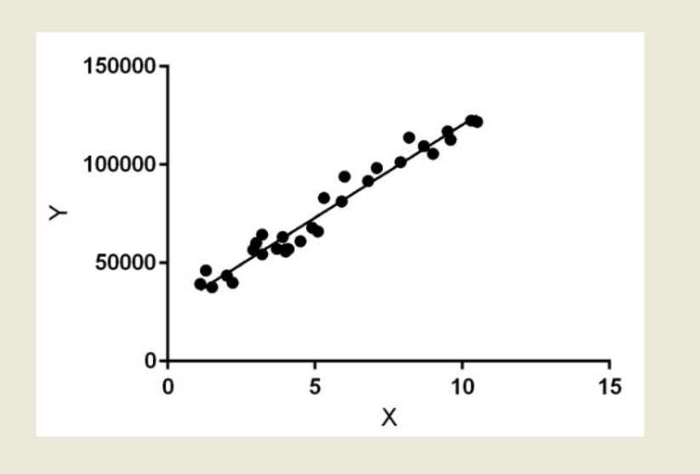
DATA COLLECTION
Accurate data collection is crucial for building a reliable Linear Regression model.
This includes gathering housing features such as size, location, amenities and historical sale prices.
The process of gathering and analyzing accurate data from various sources to find answers to research problems, trends and probabilities, etc., to evaluate possible outcomes is Known as Data Collection.
Knowledge is power, information is knowledge, and data is information in digitized form, at least as defined in IT.
Hence, data is power. But before you can leverage that data into a successful strategy for your organization or business, you need to gather it.
During data collection, the researchers must identify the data types, the sources of data, and what methods are being used

Slide 5
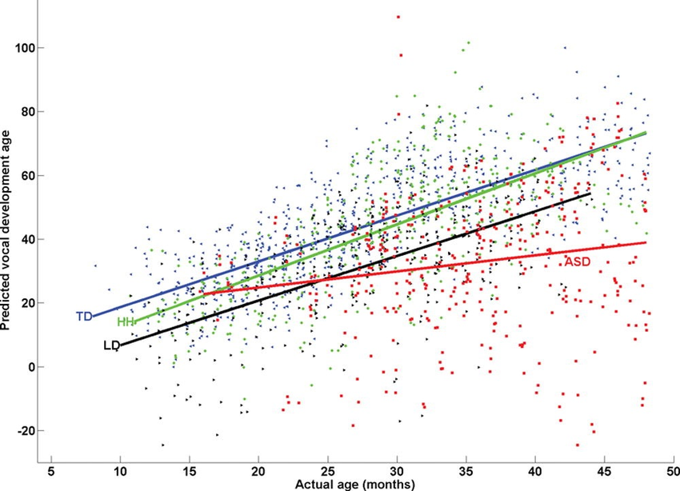
DATA PREPROCESSING
Before applying the Linear Regression model, it is essential to perform preprocessing. This involves handling missing values, outliers, and normalizing the data for data better model performance.
Handling Missing Values
Discuss strategies for handling missing values in the dataset:
Removal of rows or columns with missing values.
Imputation techniques such as mean, median, or mode imputation.
Advanced methods like K-nearest neighbors imputation or predictive modeling.

Slide 6
FEATURE SELECTION
Selecting the most relevant features is crucial for the accuracy of the model.
Feature selection methods such as correlation analysis and stepwise regression can help
identify the most influential variables.
As a data scientist working with Python, it’s crucial to understand the importance of feature
selection when building a machine learning model.
In real-life data science problems, it’s almost rare that all the variables in the dataset are
useful for building a model.
Methodically reducing the size of datasets is important as the size and variety of datasets
continue to grow.
They help reduce the dimensionality of the data, remove irrelevant or redundant
information, and improve the efficiency and accuracy of the model.

Slide 7


Slide 8

MODEL EVALUATION
The model's performance is evaluated squared errorusing metrics such as, and mean absolute error-squared, mean. This evaluation helps assess the model's predictive power
Evaluation Metrics
Discussion of commonly used evaluation metrics for regression models:
Mean Squared Error (MSE)
Root Mean Squared Error (RMSE)
Mean Absolute Error (MAE)
R-squared (R²) coefficient

Slide 9
PREDICTING HOUSE PRICES
Once the model is trained and evaluated, it can be used to make housing data.
These predictions provide predictions on new insights into future housing prices based on the
selected features.
The predicted price is then compared to the actual price in the test data.
Regression Algorithms on the other hand, predict the continuous value i.e. the expected price
of a house the number of votes that a party is likely to get in general elections, the number of
marks a student is expected to score etc.
XG BOOST is the optimal model for house price prediction, with a minimal MSE of 0.001.
Furthermore, we utilized the power of ensemble trees (XG Boost) to identify the important
features of our model. This helped us to understand the strength of the features in predicting
house prices.
Linear Regression predicts the final output-dependent value based on the given independent
features.

Slide 10

MODEL LIMITATIONS
It's important to acknowledge the limitations of the Linear Regression model, such as its assumption of linearity and sensitivity to outliers. Understanding these limitations is crucial for interpreting the model's predictions.

Slide 11
FUTURE IMPROVEMENTS
To enhance the model's accuracy, future improvements could involve exploring non-linear models such as polynomial regression or incorporating additional data sources to capture more complex relationships.
The most common type of machine learning is to Learn the Mapping Y=f(x) to make
predictions of Y for new X
This is called predictive modelling or predictive analytics and our goal is to make the most
accurate predictions possible.
The machine learning model is given the test data but without the price of the properties in
order to predict the price for them given various features for the properties.
The predicted price is then compared to the actual price in the test data.
There are three factors that influence the price of a house which include physical conditions,
concept and location.
Modern methods for prediction include trend extrapolation , Delphi Method.

Slide 12

REAL-WORLD APPLICATIONS
The insights gained from predicting house
prices using a Linear Regression model have
real-world applications in real estate
investment, property valuation, and urban
planning.
Recommendation engines are one of the
most popular applications of machine learning,
as product recommendations are featured on
most e-commerce websites.
Using machine learning models, websites
track your behaviour to recognize patterns in
your browsing history, previous purchases,
and shopping cart activity

Slide 13


Slide 14
CONCLUSION
In conclusion, the use of a Linear Regression model provides a methodical approach to predicting house prices. By understanding its principles and limitations, we can make informed decisions in the real estate market.
Reinforce the importance of predictive modeling in the real estate domain.
Encourage the audience to apply the knowledge gained from the presentation in their own projects or research endeavors.
Express gratitude to the audience for their attention and participation.

Slide 15
THANK YOU!

